Slide 2

ABP: Open source web application framework for ASP.NET Core 3.0
Halil İbrahim KALKAN

Slide 3
Why we’ve created the ABP framework?

Slide 4

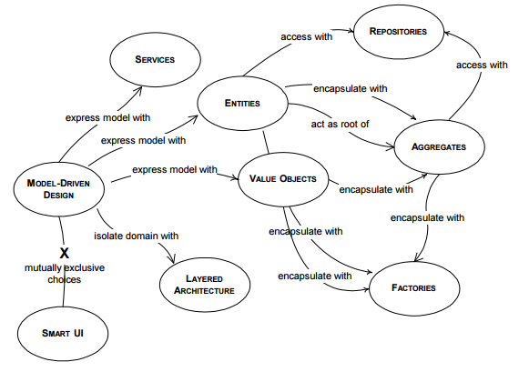
Why we’ve created the ABP framework?
Domain Driven Design
Cross Cutting Concerns
Authorization
Validation
Exception Handling
DB Connection Management
Audit Logging
Caching
...
Infrastructure
Base Classes
Abstractions
Integrations
Extension Methods / Helpers
Library Wrappers
…
Your Application
(plain) ASP.NET Core

Slide 5

Why we’ve created the ABP framework?
It’s hard to;
Develop
Maintain / Keep up to date
Document
Train developers
Needs a dedicated framework team!
Your Application(s)
Reusable
Application Framework
(plain) ASP.NET Core

Slide 6
Architecture

Slide 7
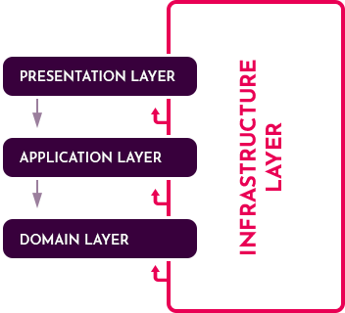
Architecture / Domain Driven Design
Application model, based on DDD patterns & principles
Layers: Domain, Application, Presentation and Infrastructure.
Well structured startup templates
Infrastructure for entities, repositories, unit of work, application services… etc.
Documentation & best practice guides

Slide 8
Architecture / Modularity
Application
Pre-Built Modules
Account
Identity Management
Tenant Management
Setting Management
Permission Management
…
Module A
Entities, Services, APIs, UI Pages, DB
Module B
Entities, Services, APIs, UI Pages, DB
Module C
Entities, Services, APIs, UI Pages, DB
Module D
Entities, Services, APIs, UI Pages, DB

Slide 9
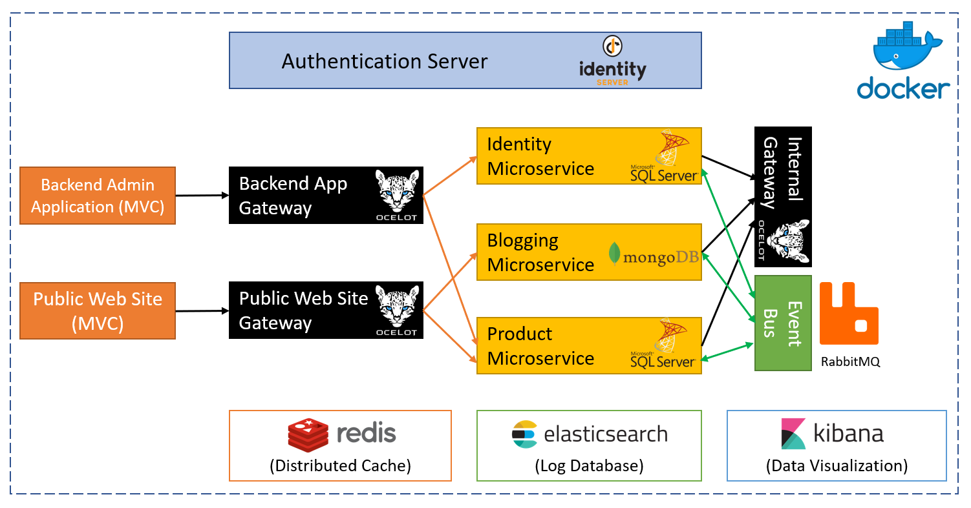
Architecture / Microservices
Communication patterns
API calls
Distributed events (pub/sub model)
IdentityServer4 integration
Pre-built modules have been designed as microservice compatible.
A complete microservice solution sample!

Slide 10
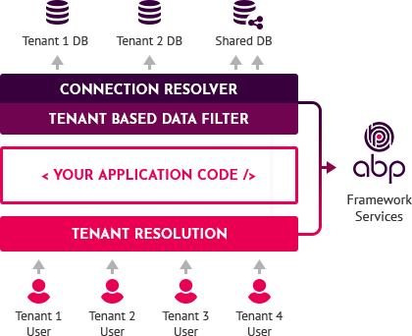
Architecture / Multi-Tenancy
Multi-tenant infrastructure
Tenant determination, auto data isolation, dynamic database selection, tenant basis setting system… etc.
Multi-tenancy unaware applications!
Pre-built tenant management module to create and manage your tenants!

Slide 11
ABP.IO vs ASP.NET Boilerplate

Slide 12
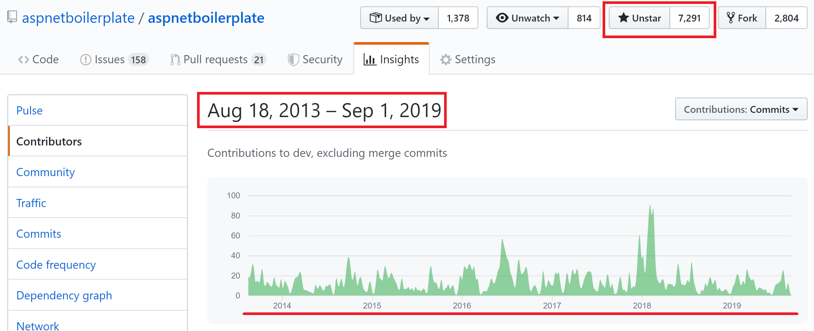
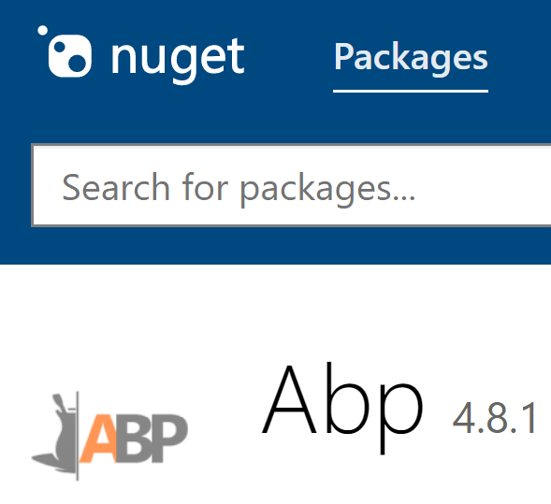
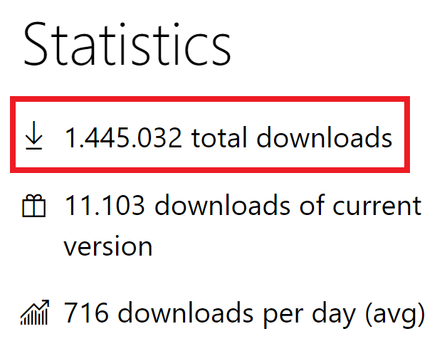

ASP.NET Boilerplate vs ABP.IO
6 years of continuous development
7,000+ stars on GitHub
1,5M downloads on NuGet

Slide 13
Demo: Create a new solution!

Slide 14
Highlights / Features

Slide 15
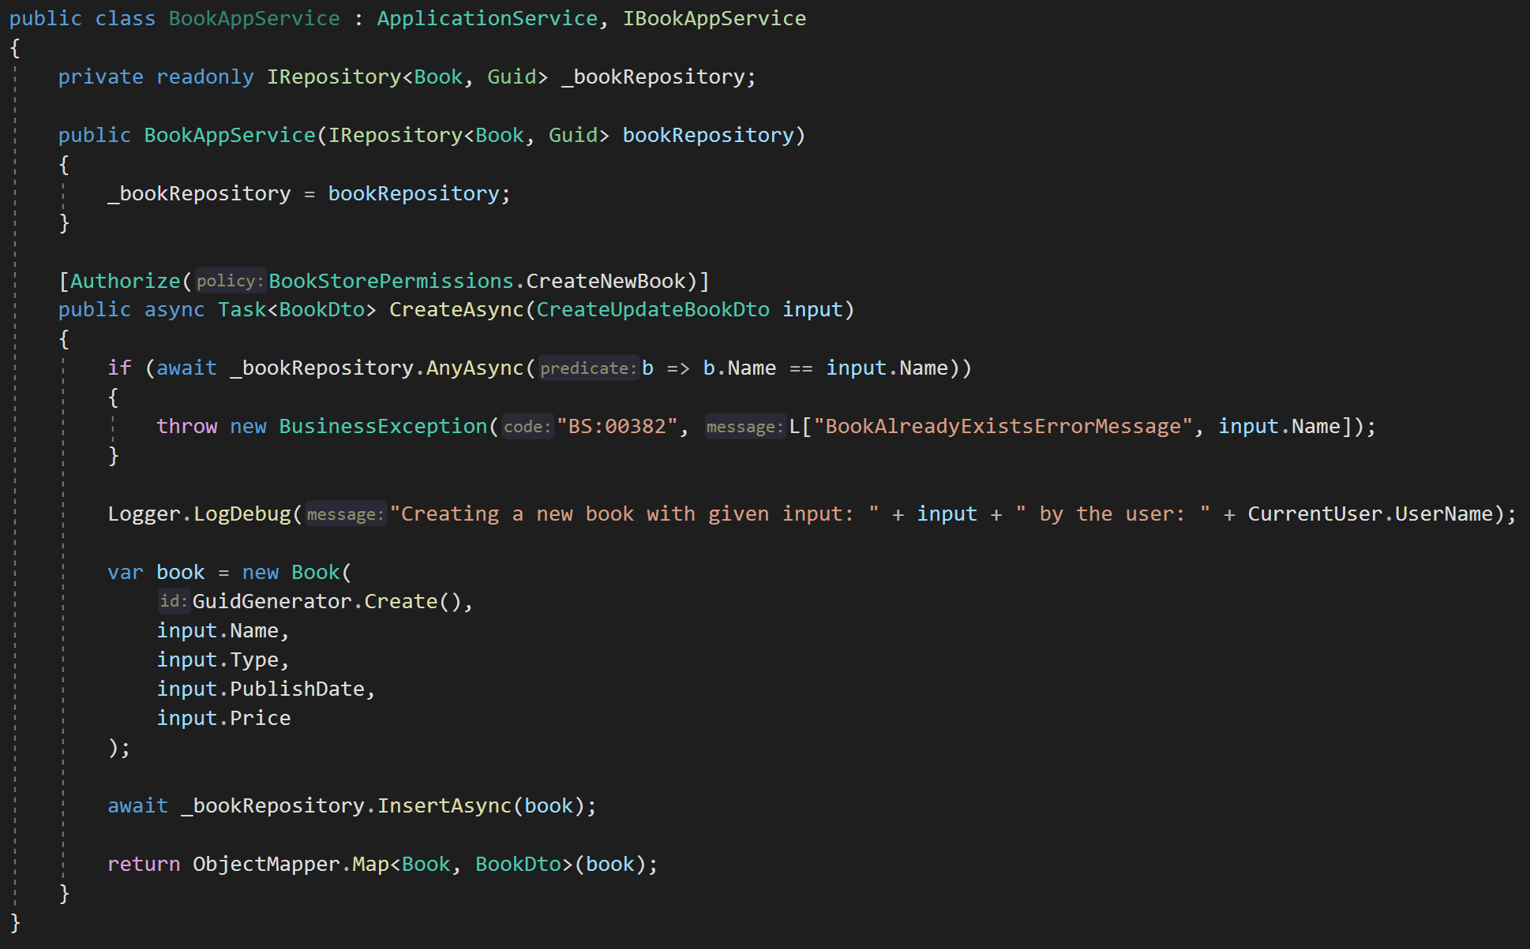
Cross-cutting Concerns
DDD Base Classes
DI Auto-Register
Generic Repositories
Authorization / Permissions
Auto Validation
Unit Of Work (Transaction Management)
Auto Audit Logging
Localization
Exception Management & Handling
Others:
ICurrentUser
ISettingProvider
IFeatureChecker
IGuidGenerator
Object2Object Map

Slide 16
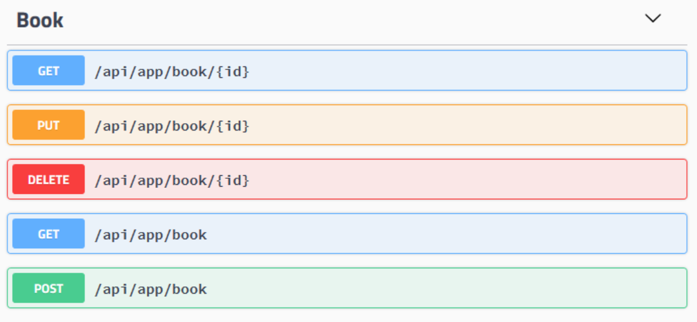
Auto HTTP API Controllers
Application Service (POCO)
HTTP API
By convention

Slide 17


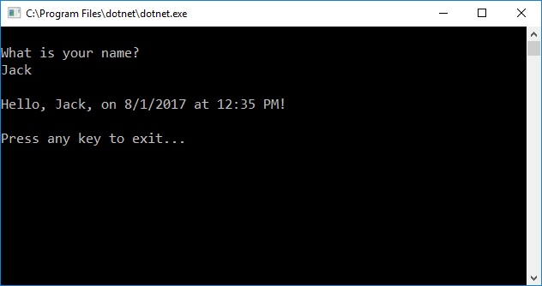

Dynamic JavaScript & C# Client Proxies
Browser
JavaScript Proxy
3rd-party client
C# Proxy
Authentication
Exception Handling
JSON De/serialization
Endpoint Configuration
NO CODE GENERATION!

Slide 18
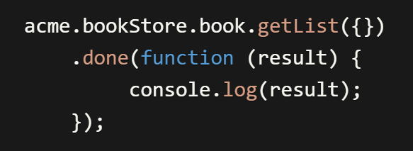
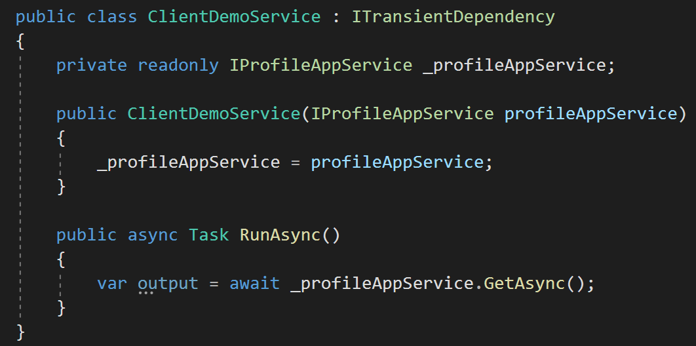
Dynamic JavaScript & C# Client Proxies
JavaScript Client
C# Client

Slide 19
Title
…

Slide 20
Title
…

Slide 21
Title
…

Slide 24
Demo intro slide

Slide 25
Code Sample Title

Slide 26
Code Sample Title

